Slide 1

Analysis of Large Graphs: Link Analysis, PageRank
Note to other teachers and users of these slides: We would be delighted if you found this our material useful in giving your own lectures. Feel free to use these slides verbatim, or to modify them to fit your own needs. If you make use of a significant portion of these slides in your own lecture, please include this message, or a link to our web site: http://www.mmds.org
Mining of Massive Datasets
Jure Leskovec, Anand Rajaraman, Jeff Ullman Stanford University
http://www.mmds.org

Slide 2
New Topic: Graph Data!
High dim. data
Locality sensitive hashing
Clustering
Graph data
PageRank, SimRank
Community Detection
Infinite data
Filtering data streams
Web advertising
Dimensionality reduction
Spam Detection
Queries on streams
Machine learning
SVM
Decision Trees
Perceptron, kNN
Apps
Recommender systems
Association Rules
Duplicate document detection

Slide 3
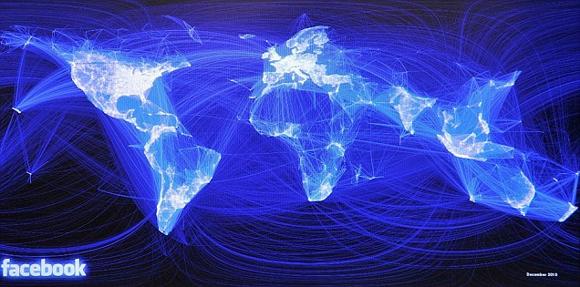
Graph Data: Social Networks
Facebook social graph
4-degrees of separation [Backstrom-Boldi-Rosa-Ugander-Vigna, 2011]

Slide 4
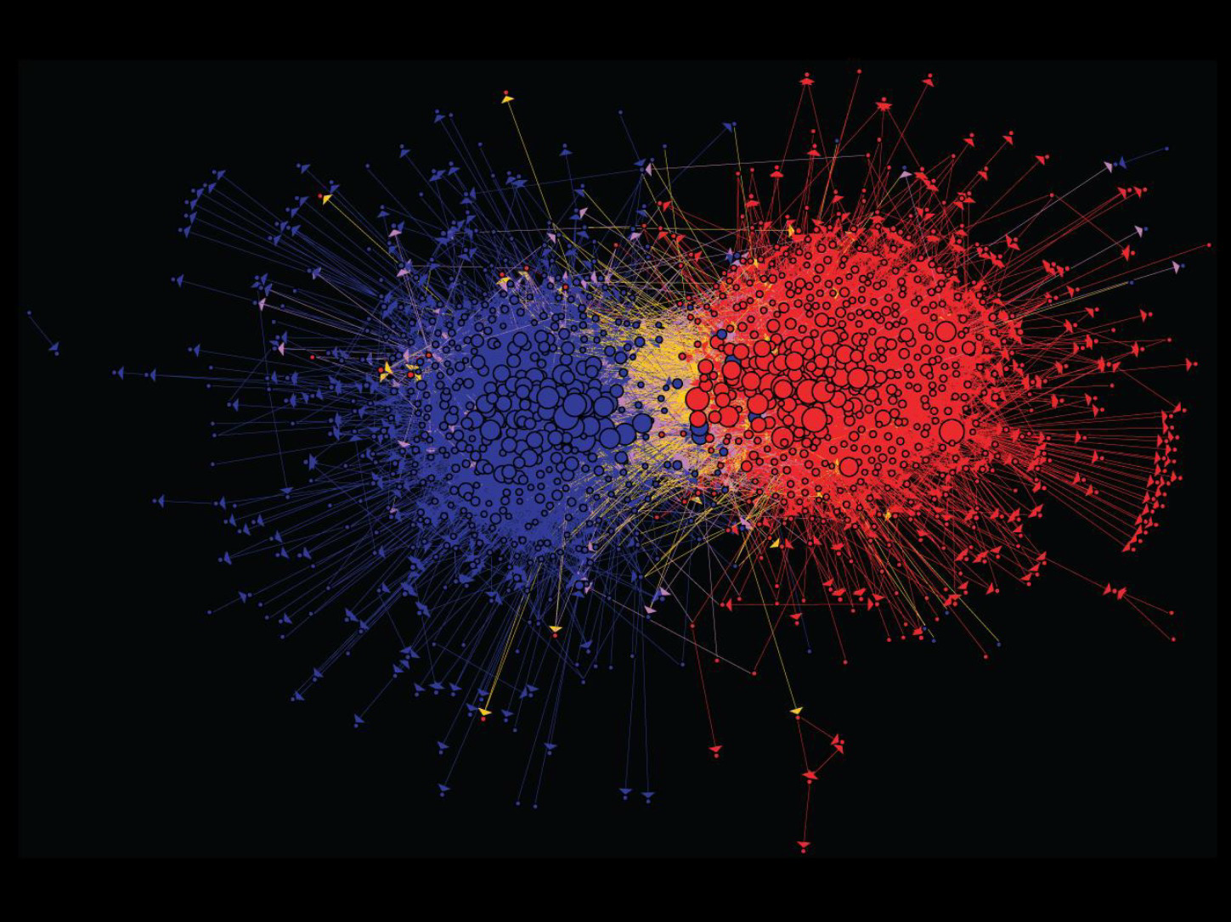
Graph Data: Media Networks
Connections between political blogs
Polarization of the network [Adamic-Glance, 2005]

Slide 5
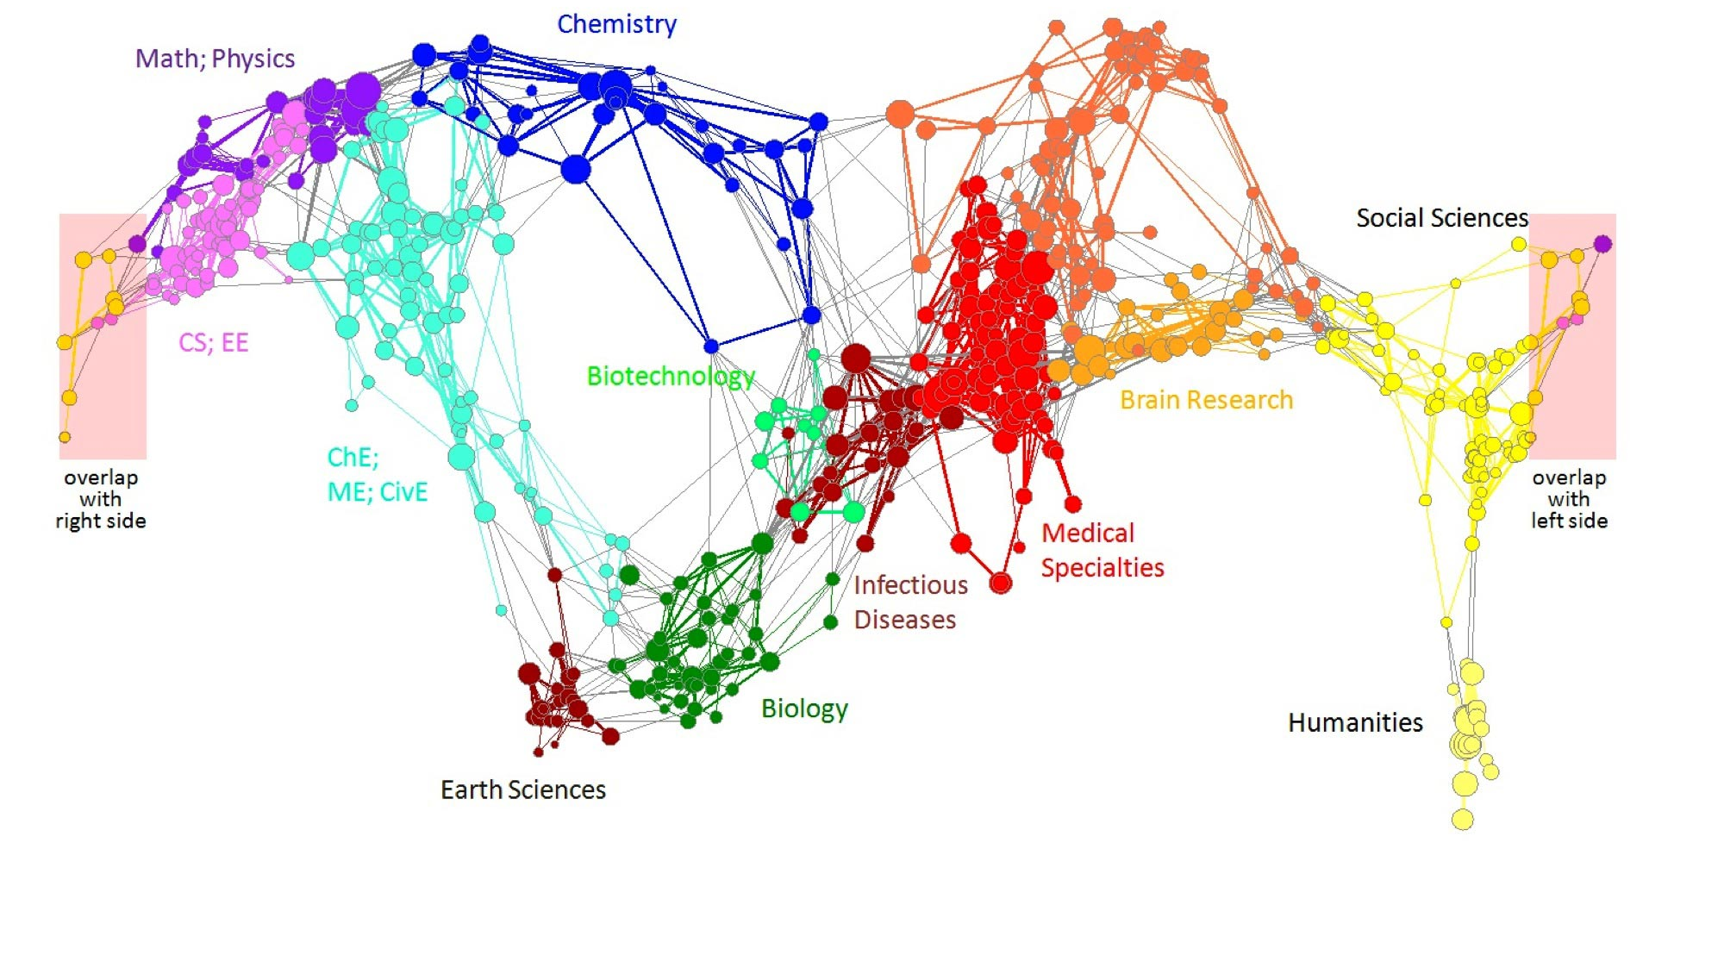
Graph Data: Information Nets
Citation networks and Maps of science
[Börner et al., 2012]

Slide 6
Graph Data: Communication Nets
domain2
domain1
router
domain3
Internet

Slide 7
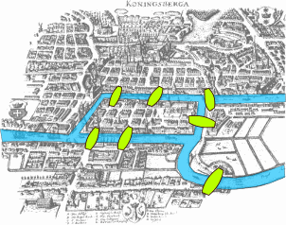
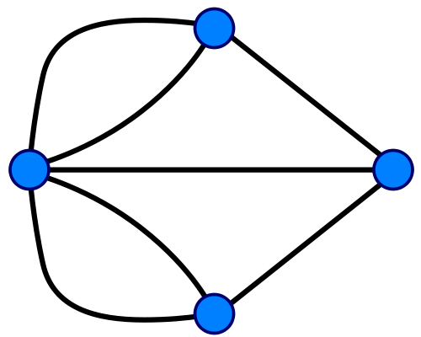
Graph Data: Technological Networks
Seven Bridges of Königsberg [Euler, 1735]
Return to the starting point by traveling each link of the graph once and only once.

Slide 8
Web as a Graph
Web as a directed graph:
Nodes: Webpages
Edges: Hyperlinks
I teach a class on Networks.
CS224W: Classes are in the Gates building
Computer Science Department at Stanford
Stanford University

Slide 9
Web as a Graph
Web as a directed graph:
Nodes: Webpages
Edges: Hyperlinks
I teach a class on Networks.
CS224W: Classes are in the Gates building
Computer Science Department at Stanford
Stanford University

Slide 10
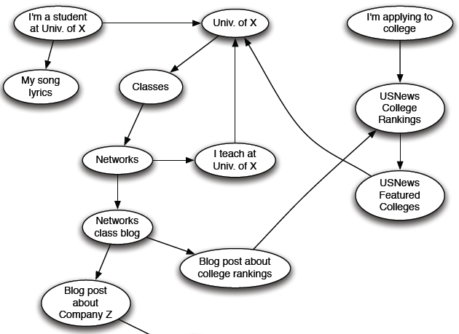
Web as a Directed Graph

Slide 11

Broad Question
How to organize the Web?
First try: Human curated Web directories
Yahoo, DMOZ, LookSmart
Second try: Web Search
Information Retrieval investigates: Find relevant docs in a small and trusted set
Newspaper articles, Patents, etc.
But: Web is huge, full of untrusted documents, random things, web spam, etc.

Slide 12
Web Search: 2 Challenges
2 challenges of web search:
(1) Web contains many sources of information Who to “trust”?
Trick: Trustworthy pages may point to each other!
(2) What is the “best” answer to query “newspaper”?
No single right answer
Trick: Pages that actually know about newspapers might all be pointing to many newspapers

Slide 13
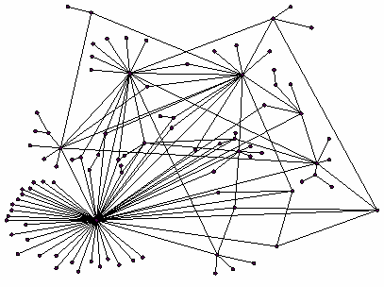
Ranking Nodes on the Graph
All web pages are not equally “important”
www.joe-schmoe.com vs. www.stanford.edu
There is large diversity in the web-graph node connectivity. Let’s rank the pages by the link structure!

Slide 14
Link Analysis Algorithms
We will cover the following Link Analysis approaches for computing importances of nodes in a graph:
Page Rank
Topic-Specific (Personalized) Page Rank
Web Spam Detection Algorithms

Slide 15
PageRank: The “Flow” Formulation

Slide 16
Links as Votes
Idea: Links as votes
Page is more important if it has more links
In-coming links? Out-going links?
Think of in-links as votes:
www.stanford.edu has 23,400 in-links
www.joe-schmoe.com has 1 in-link
Are all in-links are equal?
Links from important pages count more
Recursive question!

Slide 17
Example: PageRank Scores
B
38.4
C
34.3
A
3.3
D
3.9
E
8.1
F
3.9
1.6
1.6
1.6
1.6
1.6

Slide 18
Simple Recursive Formulation
Each link’s vote is proportional to the importance of its source page
If page j with importance r_{j} has n out-links, each link gets r_{j} / n votes
Page j’s own importance is the sum of the votes on its in-links
i
k
r_{i}/3
r_{k}/4
j
r_{j}/3
r_{j} = r_{i}/3+r_{k}/4
r_{j}/3
r_{j}/3

Slide 19

PageRank: The “Flow” Model
A “vote” from an important page is worth more
A page is important if it is pointed to by other important pages
Define a “rank” r_{j} for page j
The web in 1839
y/2
y
a/2
y/2
m
a
m
a/2
“Flow” equations:
r_{y} = r_{y} /2 + r_{a} /2
r_{a} = r_{y} /2 + r_{m}
r_{m} = r_{a} /2
$d_{i}$ … out-degree of node $i$

Slide 20
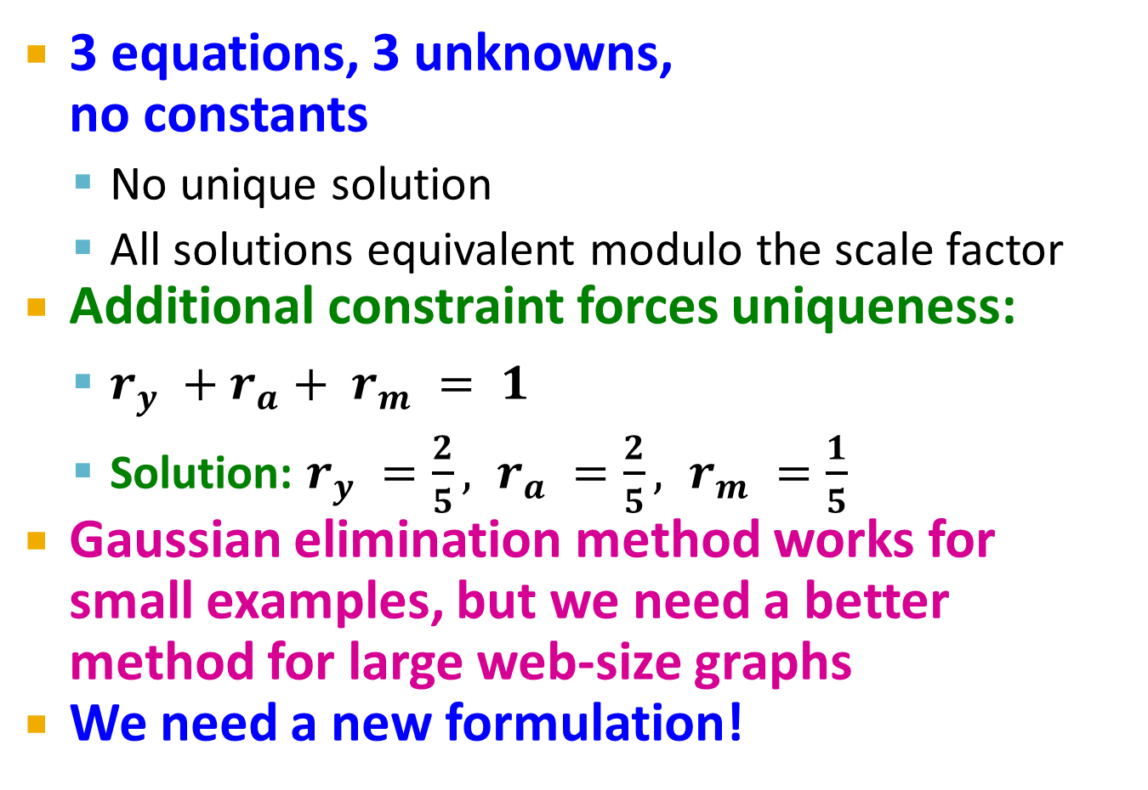
Solving the Flow Equations
Flow equations:
3 equations, 3 unknowns, no constants
No unique solution
All solutions equivalent modulo the scale factor
Additional constraint forces uniqueness:
$r_{y} +r_{a}+ r_{m} = 1$
Solution: $r_{y} =\frac{2}{5}, r_{a} =\frac{2}{5}, r_{m} =\frac{1}{5}$
Gaussian elimination method works for small examples, but we need a better method for large web-size graphs
We need a new formulation!
r_{y} = r_{y} /2 + r_{a} /2
r_{a} = r_{y} /2 + r_{m}
r_{m} = r_{a} /2

Slide 21
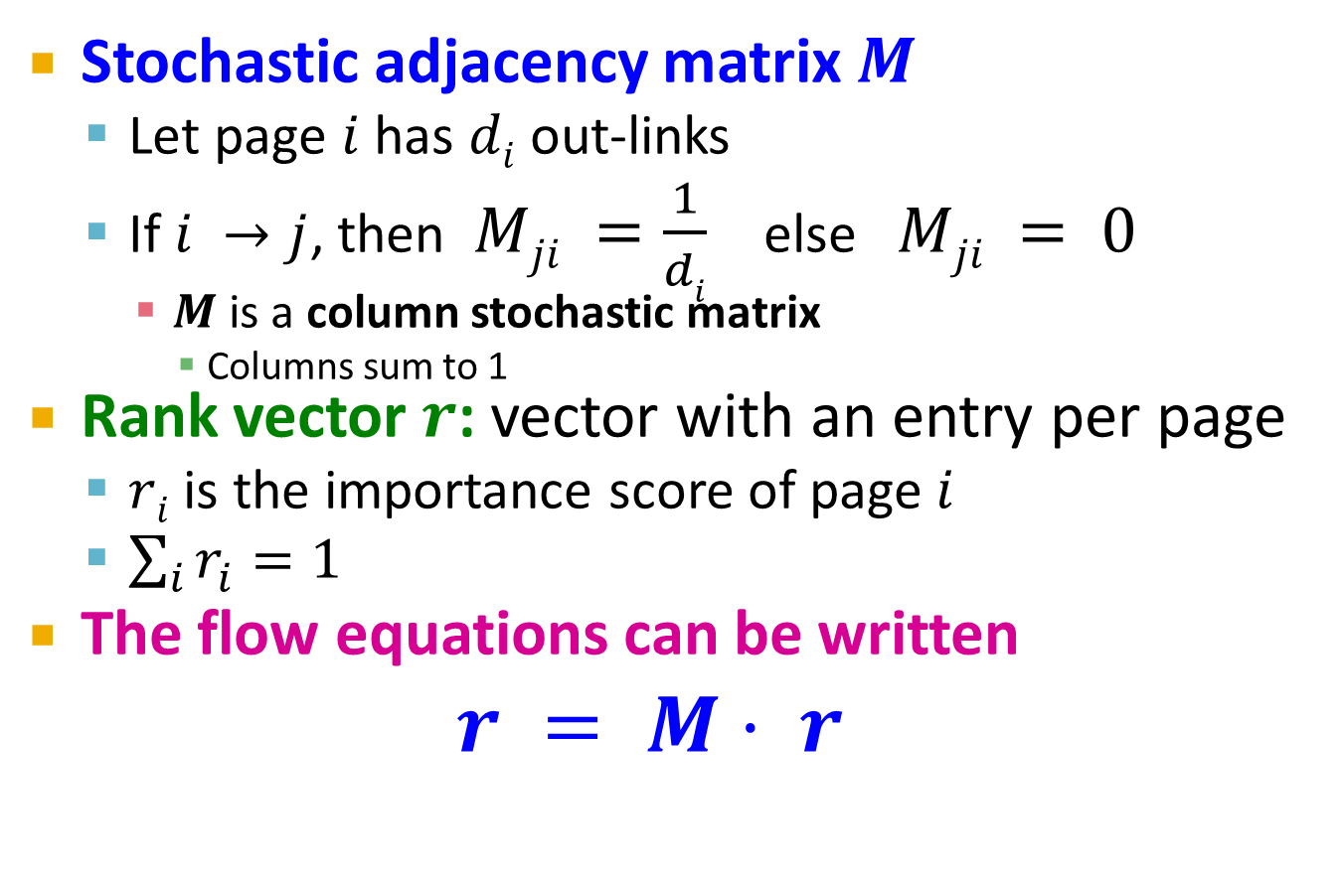
PageRank: Matrix Formulation
Stochastic adjacency matrix $M$
Let page $i$ has $di$ out-links
If $i →j$, then $Mji =\frac{1}{di}$ else $Mji = 0$
$M$ is a column stochastic matrix
Columns sum to 1
Rank vector $r$: vector with an entry per page
$ri$ is the importance score of page $i$
$\sum_{i}{r_{i}^{}=1}$
The flow equations can be written $r = M⋅ r$

Slide 22
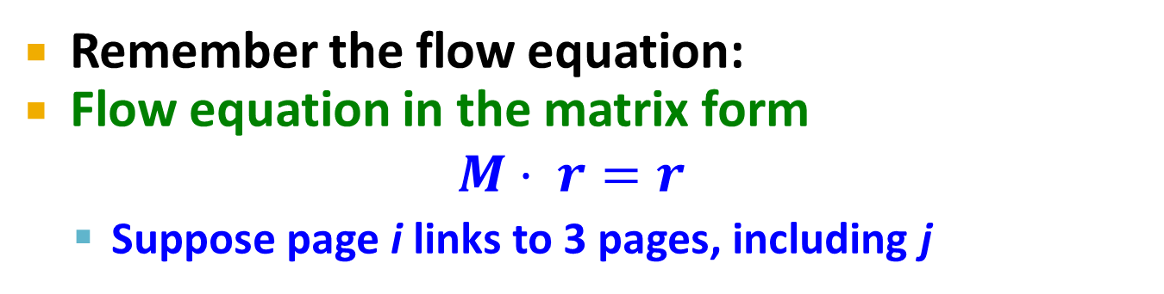
Example
Remember the flow equation:
Flow equation in the matrix form
$$M⋅ r=r$$
Suppose page i links to 3 pages, including j
i
j
r_{j}
.
=
r_{i}
1/3
M
.
r
=
r

Slide 23
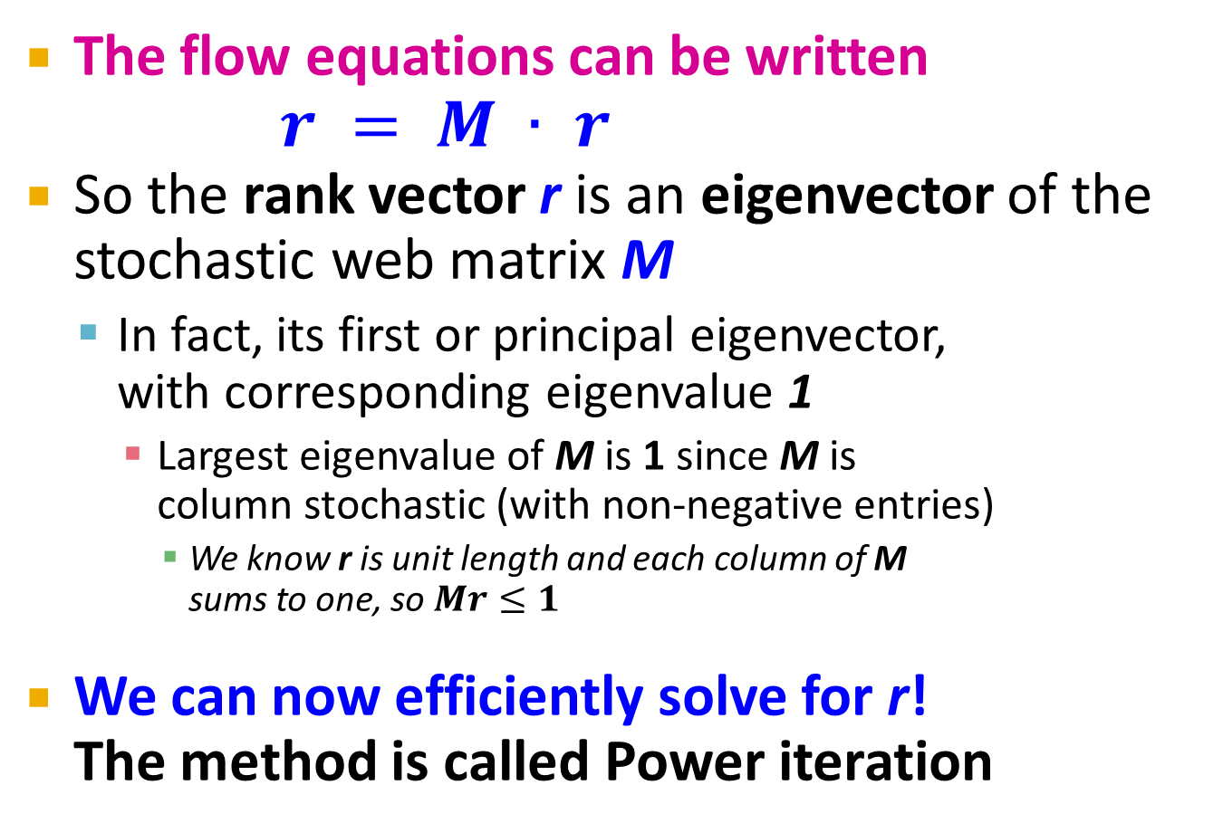

Eigenvector Formulation
The flow equations can be written $r = M ∙ r$
So the rank vector r is an eigenvector of the stochastic web matrix M
In fact, its first or principal eigenvector, with corresponding eigenvalue 1
Largest eigenvalue of M is 1 since M is column stochastic (with non-negative entries)
We know r is unit length and each column of M sums to one, so $Mr≤1$
We can now efficiently solve for r! The method is called Power iteration
NOTE: x is an eigenvector with the corresponding eigenvalue λ if: $$Ax=λx$$

Slide 24
Example: Flow Equations & M
 | y | a | m
y | ½ | ½ | 0
a | ½ | 0 | 1
m | 0 | ½ | 0
y
a
m
r = M∙r
r_{y} = r_{y} /2 + r_{a} /2
r_{a} = r_{y} /2 + r_{m}
r_{m} = r_{a} /2
y ½ ½ 0 y
a = ½ 0 1 a
m 0 ½ 0 m

Slide 25
Power Iteration Method
Given a web graph with n nodes, where the nodes are pages and edges are hyperlinks
Power iteration: a simple iterative scheme
Suppose there are N web pages
Initialize: r⁽⁰⁾ = [1/N,….,1/N]^{T}
Iterate: r^{(t+1)} = M ∙ r^{(t)}
Stop when |r^{(t+1)} – r^{(t)}|₁ < ε
d_{i} …. out-degree of node i
|x|₁ = ∑_{1≤i≤N}|x_{i}| is the L1 norm
Can use any other vector norm, e.g., Euclidean

Slide 26
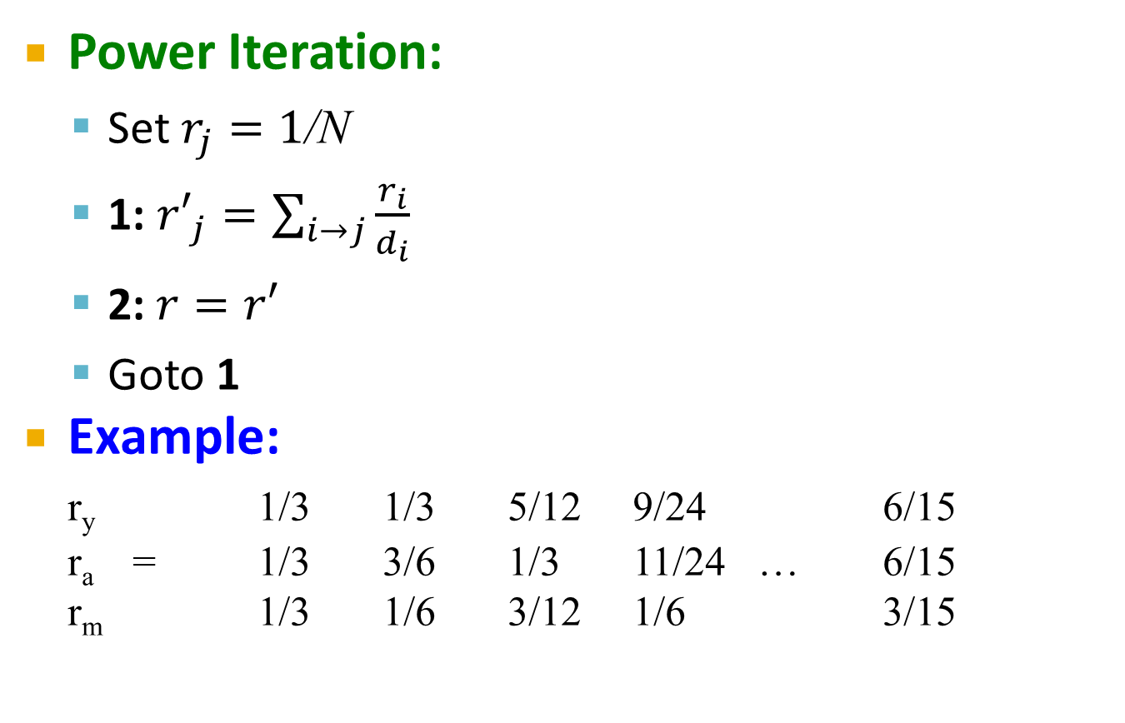
PageRank: How to solve?
Power Iteration:
Set $r_{j}=1$/N
1: ${r′}_{j}=\sum_{i→j}{\frac{r_{i}}{d_{i}}}$
2:$r=r′$
Goto 1
Example:
r_{y} 1/3 1/3 5/12 9/24 6/15
r_{a} = 1/3 3/6 1/3 11/24 … 6/15
r_{m} 1/3 1/6 3/12 1/6 3/15
y
 | y | a | m
y | ½ | ½ | 0
a | ½ | 0 | 1
m | 0 | ½ | 0
a
m
r_{y} = r_{y} /2 + r_{a} /2
r_{a} = r_{y} /2 + r_{m}
r_{m} = r_{a} /2
Iteration 0, 1, 2, …

Slide 27
PageRank: How to solve?
Power Iteration:
Set $r_{j}=1$/N
1: ${r′}_{j}=\sum_{i→j}{\frac{r_{i}}{d_{i}}}$
2:$r=r′$
Goto 1
Example:
r_{y} 1/3 1/3 5/12 9/24 6/15
r_{a} = 1/3 3/6 1/3 11/24 … 6/15
r_{m} 1/3 1/6 3/12 1/6 3/15
y
 | y | a | m
y | ½ | ½ | 0
a | ½ | 0 | 1
m | 0 | ½ | 0
a
m
r_{y} = r_{y} /2 + r_{a} /2
r_{a} = r_{y} /2 + r_{m}
r_{m} = r_{a} /2
Iteration 0, 1, 2, …

Slide 28
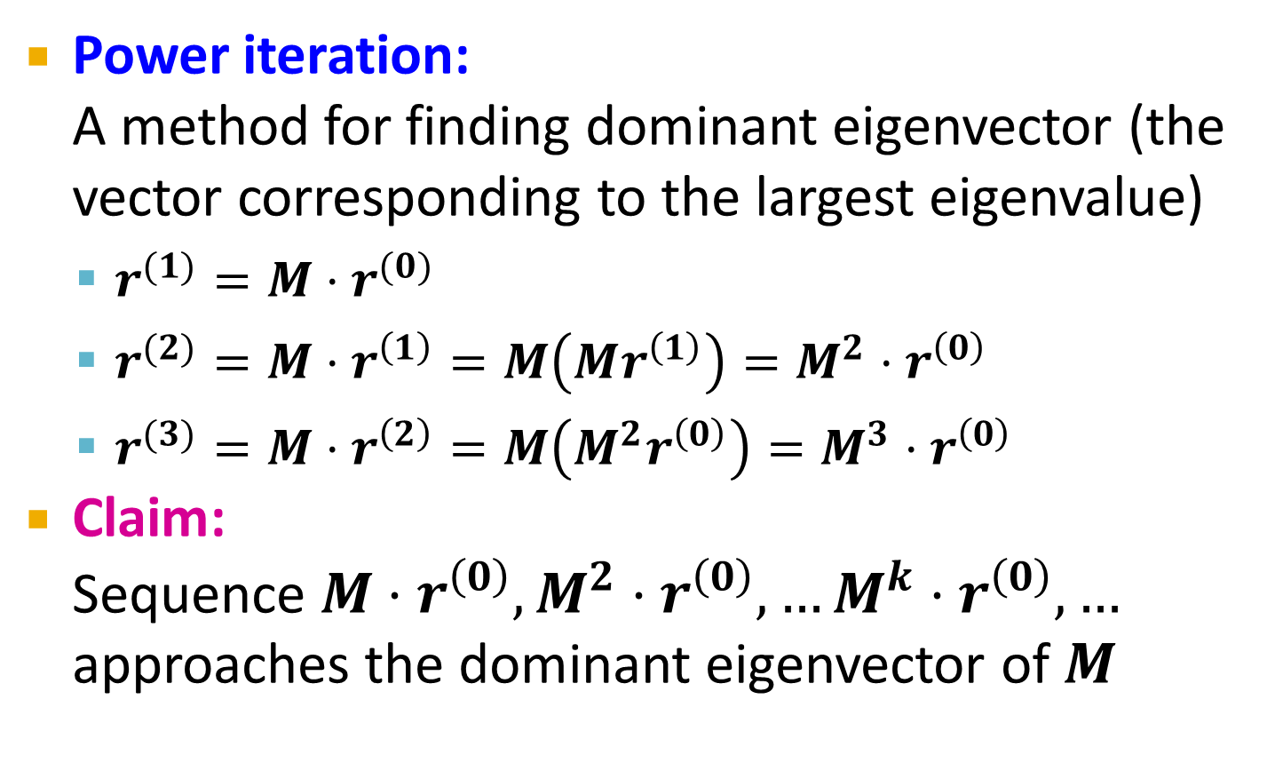
Why Power Iteration works? (1)
Details!
Power iteration: A method for finding dominant eigenvector (the vector corresponding to the largest eigenvalue)
$r^{(1)}=M⋅r^{(0)}$
$r^{(2)}=M⋅r^{\left(1\right)}=M\left(Mr^{\left(1\right)}\right)=M^{2}⋅r^{\left(0\right)}$
$r^{(3)}=M⋅r^{\left(2\right)}=M\left(M^{2}r^{\left(0\right)}\right)=M^{3}⋅r^{\left(0\right)}$
Claim: Sequence $M⋅r^{\left(0\right)},M^{2}⋅r^{\left(0\right)},…M^{k}⋅r^{\left(0\right)},…$ approaches the dominant eigenvector of $M$

Slide 29
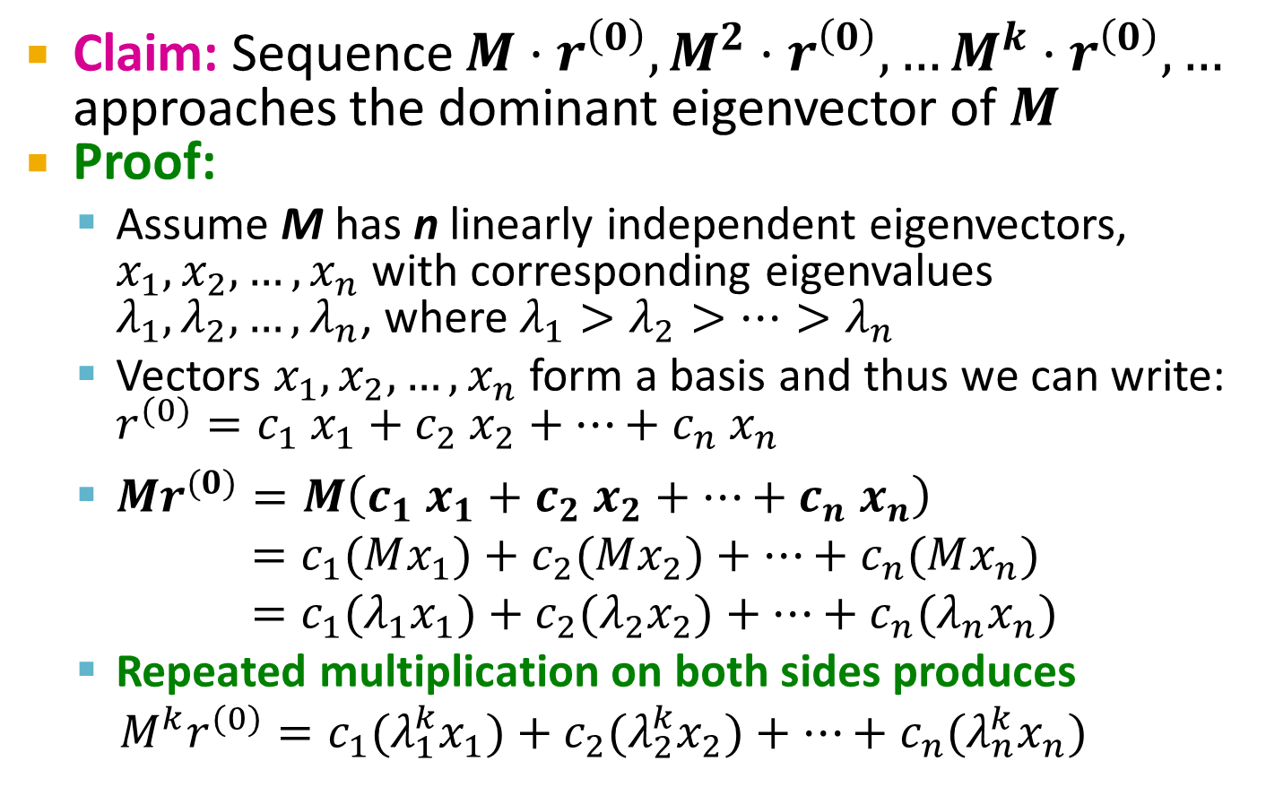
Why Power Iteration works? (2)
Details!
Claim: Sequence $M⋅r^{\left(0\right)},M^{2}⋅r^{\left(0\right)},…M^{k}⋅r^{\left(0\right)},…$ approaches the dominant eigenvector of $M$
Proof:
Assume M has n linearly independent eigenvectors, $x_{1}, x_{2}, …, x_{n}$ with corresponding eigenvalues $λ_{1},λ_{2}, …,λ_{n}$, where $λ_{1}>λ_{2}>…>λ_{n}$
Vectors $x_{1}, x_{2}, …, x_{n}$ form a basis and thus we can write: ${r^{(0)}=c_{1} x}_{1}+c_{2} x_{2}+…+c_{n} x_{n}$
$Mr^{(0)}=M\left(c_{1} x_{1}+c_{2} x_{2}+…+c_{n} x_{n}\right)$
$=c_{1}(Mx_{1})+c_{2}(Mx_{2})+…+c_{n}(Mx_{n})$
$=c_{1}(λ_{1}x_{1})+c_{2}(λ_{2}x_{2})+…+c_{n}(λ_{n}x_{n})$
Repeated multiplication on both sides produces
$M^{k}r^{(0)}=c_{1}(λ_{1}^{k}x_{1})+c_{2}(λ_{2}^{k}x_{2})+…+c_{n}(λ_{n}^{k}x_{n})$

Slide 30
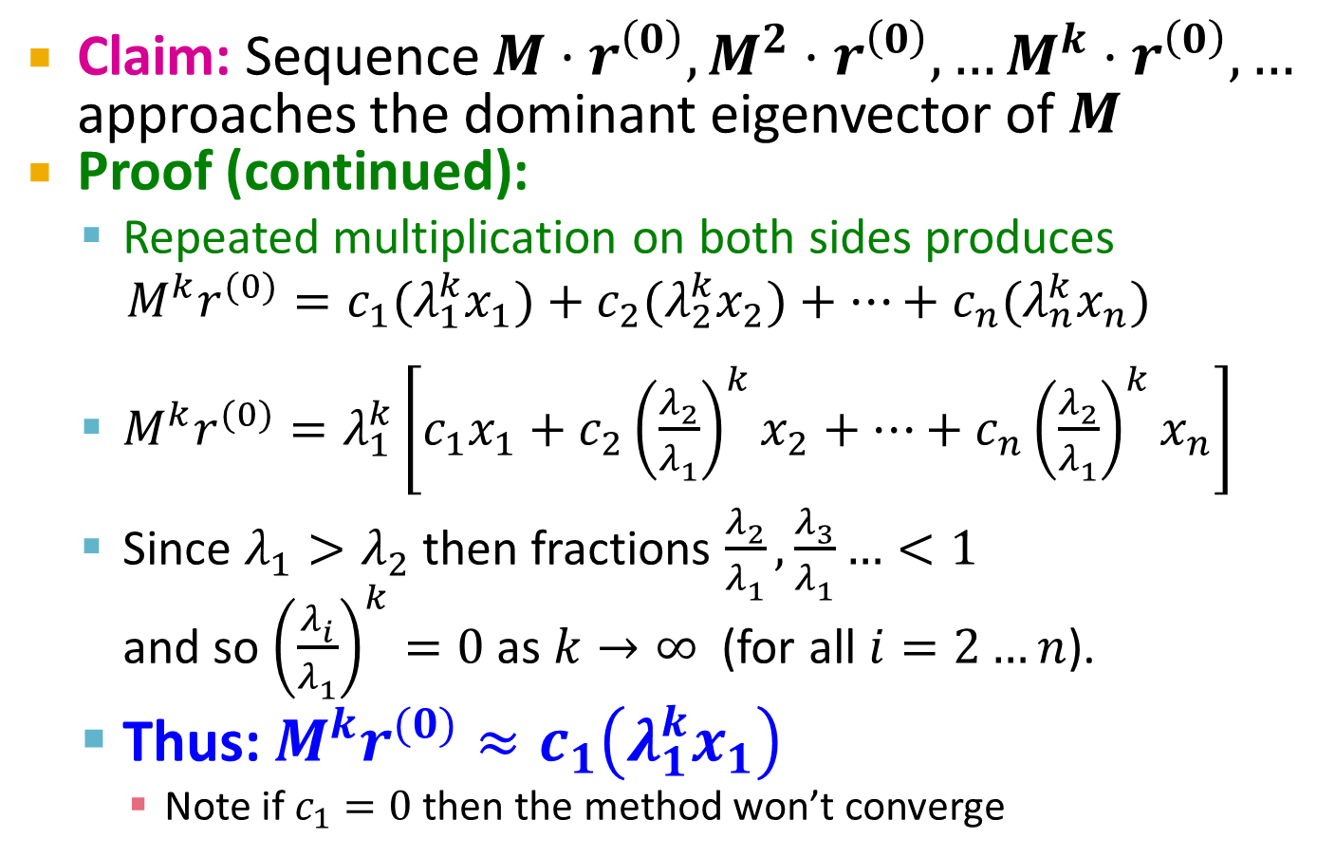
Why Power Iteration works? (3)
Details!
Claim: Sequence $M⋅r^{\left(0\right)},M^{2}⋅r^{\left(0\right)},…M^{k}⋅r^{\left(0\right)},…$ approaches the dominant eigenvector of $M$
Proof (continued):
Repeated multiplication on both sides produces
$M^{k}r^{(0)}=c_{1}(λ_{1}^{k}x_{1})+c_{2}(λ_{2}^{k}x_{2})+…+c_{n}(λ_{n}^{k}x_{n})$
$M^{k}r^{(0)}=λ_{1}^{k}\left[c_{1}x_{1}+c_{2}{\left(\frac{λ_{2}^{}}{λ_{1}^{}}\right)}^{k}x_{2}+…+c_{n}{\left(\frac{λ_{2}^{}}{λ_{1}^{}}\right)}^{k}x_{n}\right]$
Since $λ_{1}^{}>λ_{2}^{}$ then fractions $\frac{λ_{2}^{}}{λ_{1}^{}},\frac{λ_{3}^{}}{λ_{1}^{}}…<1$ and so ${\left(\frac{λ_{i}^{}}{λ_{1}^{}}\right)}^{k}=0$ as $k→∞$ (for all $i=2…n$).
Thus: $M^{k}r^{(0)}≈c_{1}\left(λ_{1}^{k}x_{1}\right)$
Note if $c_{1}=0$ then the method won’t converge

Slide 31
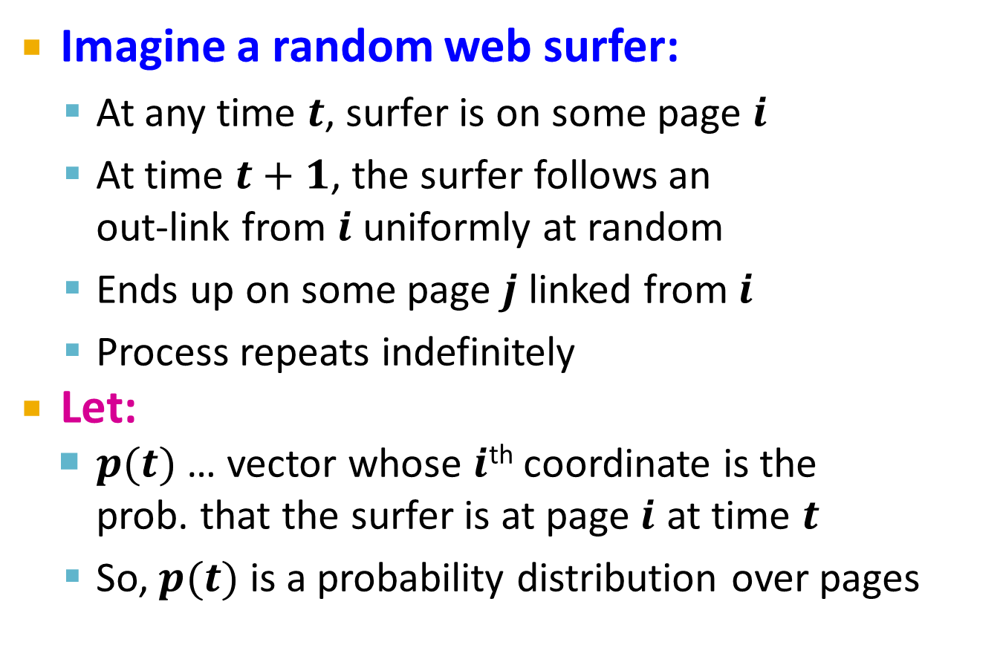
Random Walk Interpretation
Imagine a random web surfer:
At any time $t$, surfer is on some page $i$
At time $t+1$, the surfer follows an out-link from $i$ uniformly at random
Ends up on some page $j$ linked from $i$
Process repeats indefinitely
Let:
$p(t)$ … vector whose $i$^{th} coordinate is the prob. that the surfer is at page $i$ at time $t$
So, $p(t)$ is a probability distribution over pages
i₁
i₂
i₃
j

Slide 32
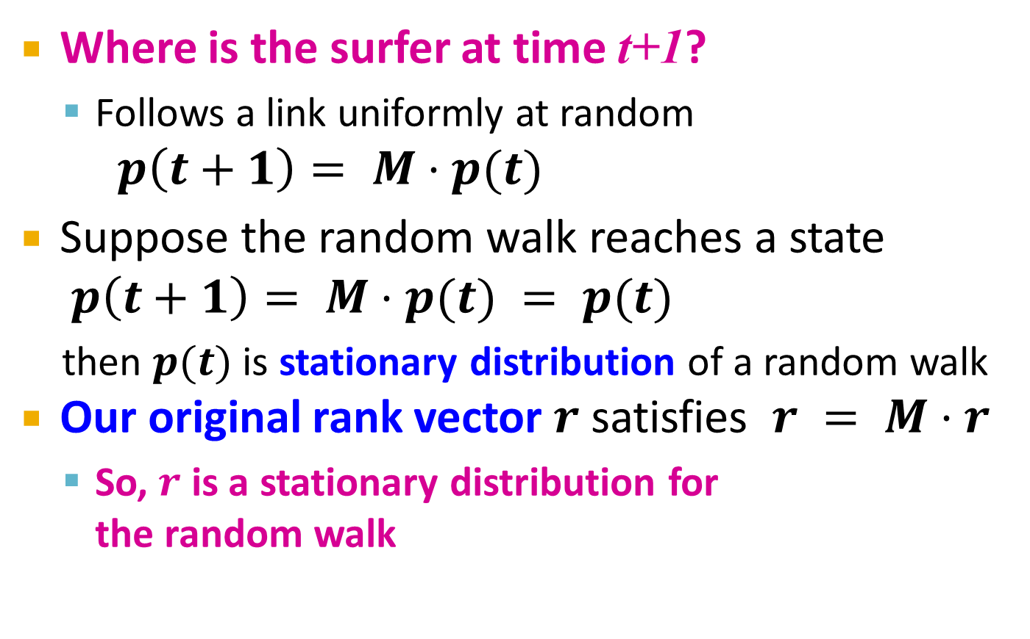
The Stationary Distribution
i₁
i₂
i₃
Where is the surfer at time t+1?
Follows a link uniformly at random
$p\left(t+1\right)= M⋅p(t)$
Suppose the random walk reaches a state $p\left(t+1\right)= M⋅p(t) = p(t)$
then $p(t)$ is stationary distribution of a random walk
Our original rank vector $r$ satisfies $r = M⋅r$
So, $r$ is a stationary distribution for the random walk
j

Slide 33
Existence and Uniqueness
A central result from the theory of random walks (a.k.a. Markov processes):
For graphs that satisfy certain conditions, the stationary distribution is unique and eventually will be reached no matter what the initial probability distribution at time t = 0

Slide 34
PageRank: The Google Formulation

Slide 35
PageRank: Three Questions
Does this converge?
Does it converge to what we want?
Are results reasonable?
or
equivalently

Slide 36
Does this converge?
Example:
r_{a} 1 0 1 0
r_{b} 0 1 0 1
a
b
=
Iteration 0, 1, 2, …

Slide 37
Does it converge to what we want?
Example:
r_{a} 1 0 0 0
r_{b} 0 1 0 0
a
b
=
Iteration 0, 1, 2, …

Slide 38
PageRank: Problems
Dead end
2 problems:
(1) Some pages are dead ends (have no out-links)
Random walk has “nowhere” to go to
Such pages cause importance to “leak out”
(2) Spider traps: (all out-links are within the group)
Random walked gets “stuck” in a trap
And eventually spider traps absorb all importance
Spider trap

Slide 39

Problem: Spider Traps
Power Iteration:
Set $r_{j}=1$
$r_{j}=\sum_{i→j}{\frac{r_{i}}{d_{i}}}$
And iterate
Example:
r_{y} 1/3 2/6 3/12 5/24 0
r_{a} = 1/3 1/6 2/12 3/24 … 0
r_{m} 1/3 3/6 7/12 16/24 1
y
 | y | a | m
y | ½ | ½ | 0
a | ½ | 0 | 0
m | 0 | ½ | 1
a
m
m is a spider trap
r_{y} = r_{y} /2 + r_{a} /2
r_{a} = r_{y} /2
r_{m} = r_{a} /2 + r_{m}
Iteration 0, 1, 2, …
All the PageRank score gets “trapped” in node m.

Slide 40
Solution: Teleports!
The Google solution for spider traps: At each time step, the random surfer has two options
With prob. β, follow a link at random
With prob. 1-β, jump to some random page
Common values for β are in the range 0.8 to 0.9
Surfer will teleport out of spider trap within a few time steps
y
y
a
m
a
m

Slide 41

Problem: Dead Ends
Power Iteration:
Set $r_{j}=1$
$r_{j}=\sum_{i→j}{\frac{r_{i}}{d_{i}}}$
And iterate
Example:
r_{y} 1/3 2/6 3/12 5/24 0
r_{a} = 1/3 1/6 2/12 3/24 … 0
r_{m} 1/3 1/6 1/12 2/24 0
y
 | y | a | m
y | ½ | ½ | 0
a | ½ | 0 | 0
m | 0 | ½ | 0
a
m
r_{y} = r_{y} /2 + r_{a} /2
r_{a} = r_{y} /2
r_{m} = r_{a} /2
Iteration 0, 1, 2, …
Here the PageRank “leaks” out since the matrix is not stochastic.

Slide 42
Solution: Always Teleport!
Teleports: Follow random teleport links with probability 1.0 from dead-ends
Adjust matrix accordingly
y
y
a
m
a
m
 | y | a | m
y | ½ | ½ | 0
a | ½ | 0 | 0
m | 0 | ½ | 0
 | y | a | m
y | ½ | ½ | ⅓
a | ½ | 0 | ⅓
m | 0 | ½ | ⅓

Slide 43
Why Teleports Solve the Problem?
Why are dead-ends and spider traps a problem and why do teleports solve the problem?
Spider-traps are not a problem, but with traps PageRank scores are not what we want
Solution: Never get stuck in a spider trap by teleporting out of it in a finite number of steps
Dead-ends are a problem
The matrix is not column stochastic so our initial assumptions are not met
Solution: Make matrix column stochastic by always teleporting when there is nowhere else to go

Slide 44
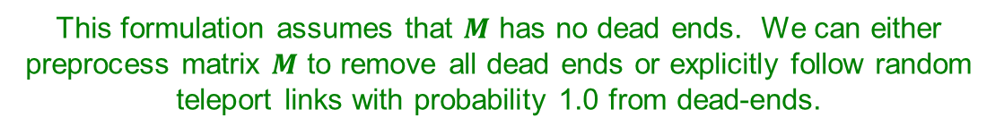
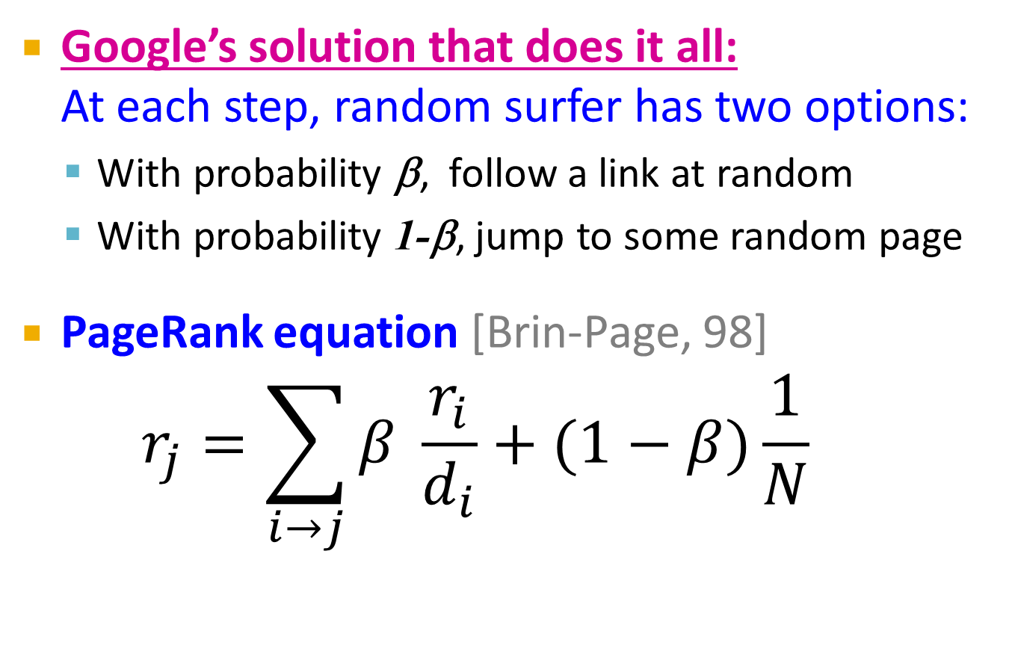
Solution: Random Teleports
Google’s solution that does it all: At each step, random surfer has two options:
With probability β, follow a link at random
With probability 1-β, jump to some random page
PageRank equation [Brin-Page, 98] $r_{j}=\sum_{i→j}{β \frac{r_{i}}{d_{i}}}+(1−β)\frac{1}{N}$
d_{i} … out-degree of node i
This formulation assumes that $M$ has no dead ends. We can either preprocess matrix $M$ to remove all dead ends or explicitly follow random teleport links with probability 1.0 from dead-ends.

Slide 45
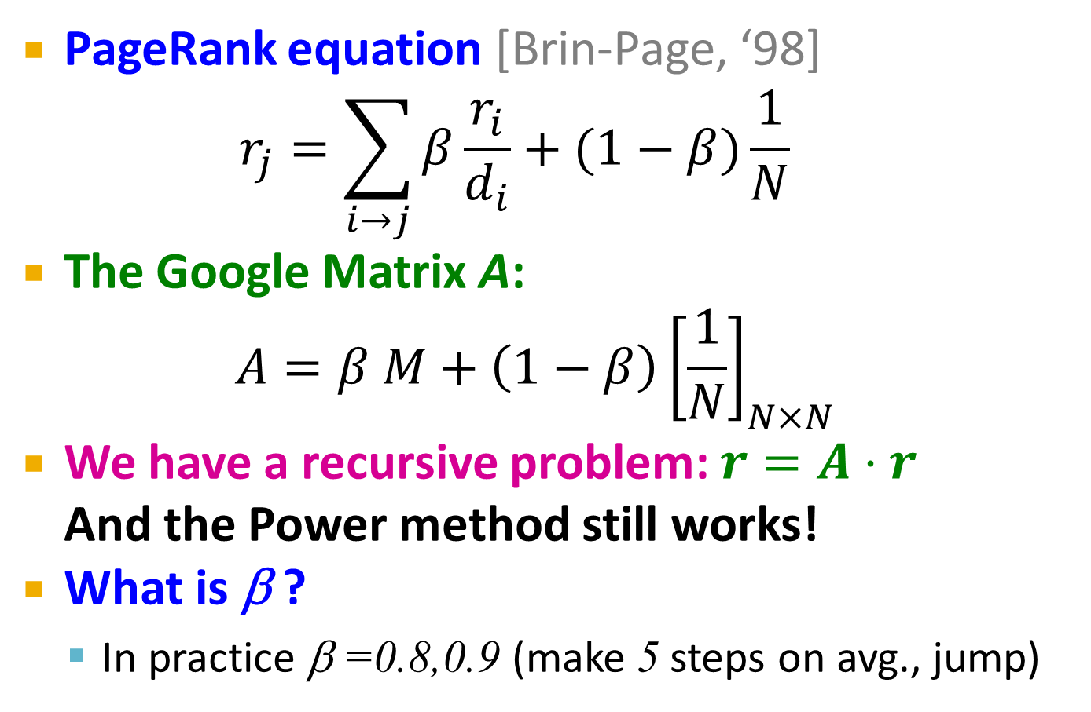
The Google Matrix
PageRank equation [Brin-Page, ‘98] $r_{j}=\sum_{i→j}{β\frac{r_{i}}{d_{i}}}+(1−β)\frac{1}{N}$
The Google Matrix A:
$$A=β M+\left(1−β\right){\left[\frac{1}{N}\right]}_{N×N}$$
We have a recursive problem: $r=A⋅r$ And the Power method still works!
What is β ?
In practice β =0.8,0.9 (make 5 steps on avg., jump)
[1/N]_{NxN}…N by N matrix where all entries are 1/N

Slide 46
Random Teleports (β = 0.8)
M
[1/N]_{NxN}
7/15
y
1/2 1/2 0
1/2 0 0
0 1/2 1
1/3 1/3 1/3
1/3 1/3 1/3
1/3 1/3 1/3
0.8
+ 0.2
7/15
1/15
7/15
1/15
y 7/15 7/15 1/15
a 7/15 1/15 1/15
m 1/15 7/15 13/15
13/15
a
7/15
m
1/15
1/15
A
y
a =
m
1/3
1/3
1/3
0.33
0.20
0.46
0.24
0.20
0.52
0.26
0.18
0.56
7/33
5/33
21/33
. . .

Slide 47
How do we actually compute the PageRank?

Slide 48
Computing Page Rank
Key step is matrix-vector multiplication
r^{new} = A ∙ r^{old}
Easy if we have enough main memory to hold A, r^{old}, r^{new}
Say N = 1 billion pages
We need 4 bytes for each entry (say)
2 billion entries for vectors, approx 8GB
Matrix A has N² entries
10¹⁸ is a large number!
A = β∙M + (1-β) [1/N]_{NxN}
½ ½ 0
½ 0 0
0 ½ 1
1/3 1/3 1/3
1/3 1/3 1/3
1/3 1/3 1/3
A =
0.8
+0.2
7/15 7/15 1/15
7/15 1/15 1/15
1/15 7/15 13/15
=

Slide 49
Matrix Formulation
Suppose there are N pages
Consider page i, with d_{i} out-links
We have M_{ji} = 1/|d_{i}| when i → j and M_{ji} = 0 otherwise
The random teleport is equivalent to:
Adding a teleport link from i to every other page and setting transition probability to (1-β)/N
Reducing the probability of following each out-link from 1/|d_{i}| to β/|d_{i}|
Equivalent: Tax each page a fraction (1-β) of its score and redistribute evenly

Slide 50
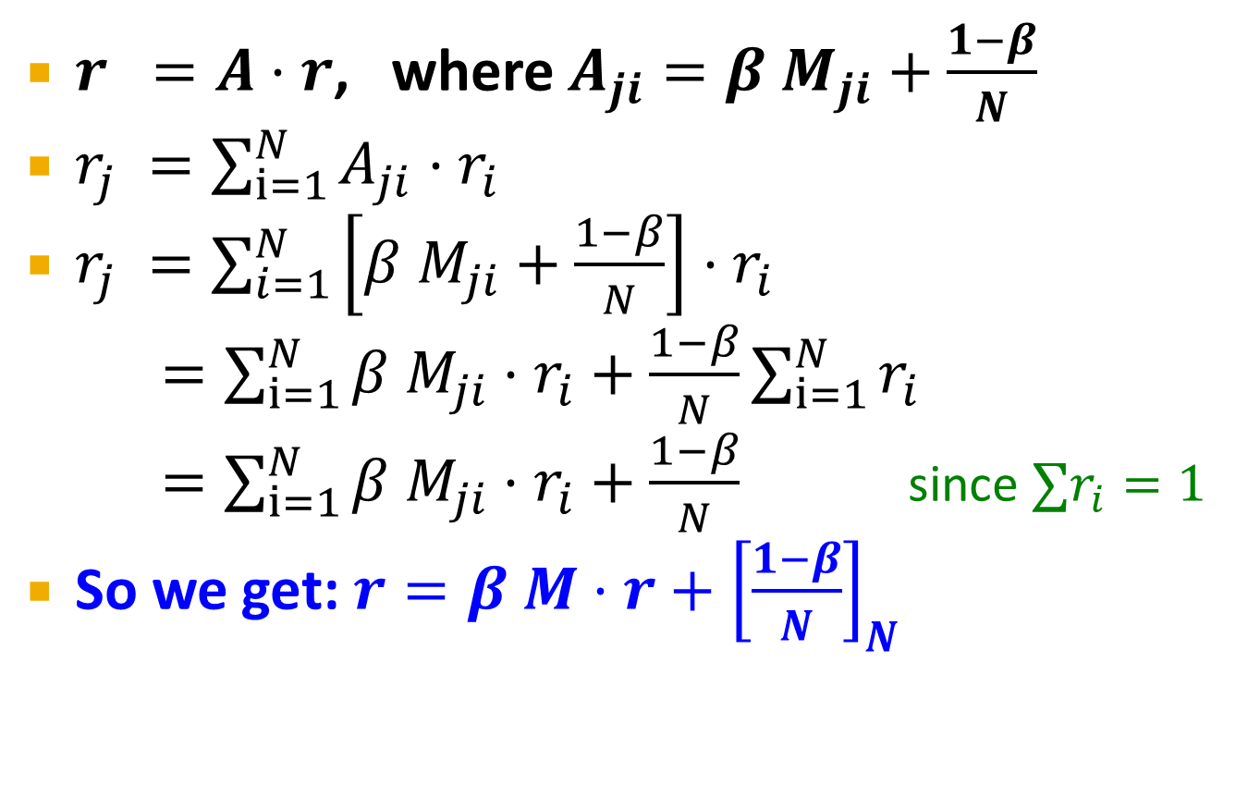
Rearranging the Equation
$r =A⋅r$, where $A_{ji}=β{ M}_{ji}+\frac{1−β}{N}$
$r_{j} =\sum_{i=1}^{N}{A_{ji}⋅r_{i}}$
$r_{j} =\sum_{i=1}^{N}{\left[β{ M}_{ji}+\frac{1−β}{N}\right]⋅r_{i}}$
$=\sum_{i=1}^{N}{β{ M}_{ji}⋅r_{i}+\frac{1−β}{N}}\sum_{i=1}^{N}{r_{i}}$
$=\sum_{i=1}^{N}{β{ M}_{ji}⋅r_{i}+\frac{1−β}{N}}$ since $∑r_{i}=1$
So we get: $r=β M⋅r+{\left[\frac{1−β}{N}\right]}_{N}$
Note: Here we assumed M has no dead-ends
[x]_{N} … a vector of length N with all entries x

Slide 51
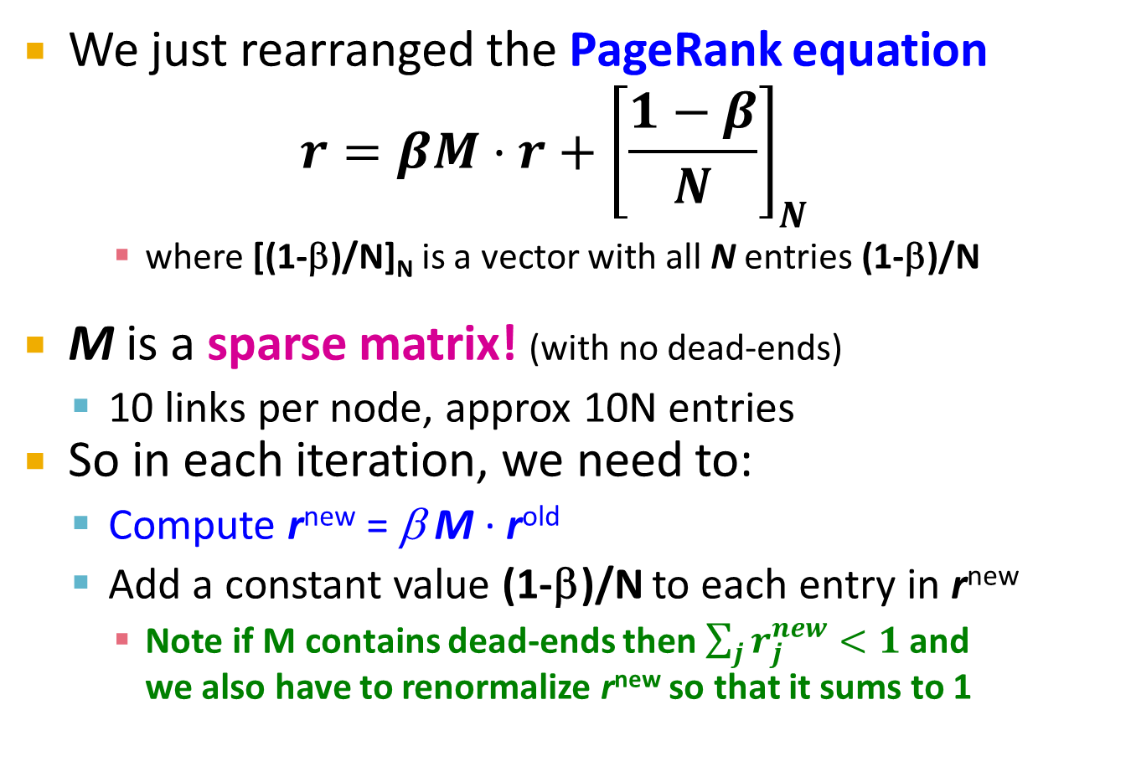
Sparse Matrix Formulation
We just rearranged the PageRank equation
$$r=βM⋅r+{\left[\frac{1−β}{N}\right]}_{N}$$
where [(1-β)/N]_{N} is a vector with all N entries (1-β)/N
M is a sparse matrix! (with no dead-ends)
10 links per node, approx 10N entries
So in each iteration, we need to:
Compute r^{new} = β M ∙ r^{old}
Add a constant value (1-β)/N to each entry in r^{new}
Note if M contains dead-ends then $\sum_{j}{r_{j}^{new}}<1$ and we also have to renormalize r^{new} so that it sums to 1

Slide 52
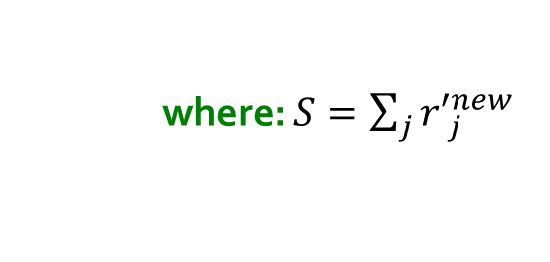

PageRank: The Complete Algorithm
Input: Graph $G$ and parameter $β$
Directed graph $G$ (can have spider traps and dead ends)
Parameter $β$
Output: PageRank vector $r^{new}$
Set: $r_{j}^{old} =\frac{1}{N}$
repeat until convergence: $\sum_{j}{\left|r_{j}^{new}−r_{j}^{old}\right|>ε}$
$∀j: {r′}_{j}^{new}=\sum_{i→j}{β \frac{r_{i}^{old}}{d_{i}}}$
${r′}_{j}^{new}=0$ if in-degree of $j$ is 0
Now re-insert the leaked PageRank:
$∀j: r_{j}^{new}={r^{′}}_{j}^{new}+\frac{1−S}{N}$
$r^{old}=r^{new}$
where: $S=\sum_{j}{{r′}_{j}^{new}}$
If the graph has no dead-ends then the amount of leaked PageRank is 1-β. But since we have dead-ends the amount of leaked PageRank may be larger. We have to explicitly account for it by computing S.

Slide 53
Sparse Matrix Encoding
Encode sparse matrix using only nonzero entries
Space proportional roughly to number of links
Say 10N, or 4*10*1 billion = 40GB
Still won’t fit in memory, but will fit on disk
source
node
degree
destination nodes
0 | 3 | 1, 5, 7
1 | 5 | 17, 64, 113, 117, 245
2 | 2 | 13, 23

Slide 54
Basic Algorithm: Update Step
Assume enough RAM to fit r^{new} into memory
Store r^{old} and matrix M on disk
1 step of power-iteration is:
Initialize all entries of r^{new} = (1-β) / N
For each page i (of out-degree d_{i}):
Read into memory: i, d_{i}, dest₁, …, dest_{di}, r^{old}(i)
For j = 1…d_{i}
r^{new}(dest_{j}) += β r^{old}(i) / d_{i}
0
r^{new}
source
degree
destination
r^{old}
0
1
0 | 3 | 1, 5, 6
1 | 4 | 17, 64, 113, 117
2 | 2 | 13, 23
1
2
2
3
3
4
4
5
5
6
6
Notes:
Remember to say that we first initialize r^new to 1-beta/n

Slide 55
Analysis
Assume enough RAM to fit r^{new} into memory
Store r^{old} and matrix M on disk
In each iteration, we have to:
Read r^{old} and M
Write r^{new} back to disk
Cost per iteration of Power method: = 2|r| + |M|
Question:
What if we could not even fit r^{new} in memory?

Slide 56
Block-based Update Algorithm
r^{new}
src
degree
destination
r^{old}
0
0 | 4 | 0, 1, 3, 5
1 | 2 | 0, 5
2 | 2 | 3, 4
0
1
1
2
2
3
4
3
M
5
4
5
Break r^{new} into k blocks that fit in memory
Scan M and r^{old} once for each block

Slide 57
Analysis of Block Update
Similar to nested-loop join in databases
Break r^{new} into k blocks that fit in memory
Scan M and r^{old} once for each block
Total cost:
k scans of M and r^{old}
Cost per iteration of Power method: k(|M| + |r|) + |r| = k|M| + (k+1)|r|
Can we do better?
Hint: M is much bigger than r (approx 10-20x), so we must avoid reading it k times per iteration

Slide 58
Block-Stripe Update Algorithm
src
degree
destination
r^{new}
0 | 4 | 0, 1
1 | 3 | 0
2 | 2 | 1
0
1
r^{old}
0
1
2
2
0 | 4 | 3
2 | 2 | 3
3
4
3
5
0 | 4 | 5
1 | 3 | 5
2 | 2 | 4
4
5
Break M into stripes! Each stripe contains only destination nodes in the corresponding block of r^{new}

Slide 59
Block-Stripe Analysis
Break M into stripes
Each stripe contains only destination nodes in the corresponding block of r^{new}
Some additional overhead per stripe
But it is usually worth it
Cost per iteration of Power method: =|M|(1+ε) + (k+1)|r|

Slide 60
Some Problems with Page Rank
Measures generic popularity of a page
Biased against topic-specific authorities
Solution: Topic-Specific PageRank (next)
Uses a single measure of importance
Other models of importance
Solution: Hubs-and-Authorities
Susceptible to Link spam
Artificial link topographies created in order to boost page rank
Solution: TrustRank

